Slide 1
Graphene & Nanowires: Applications
Kevin Babb & Petar Petrov
Physics 141A Presentation
March 5, 2013

Slide 2
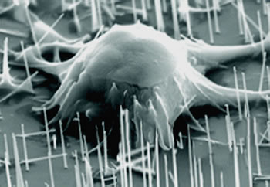
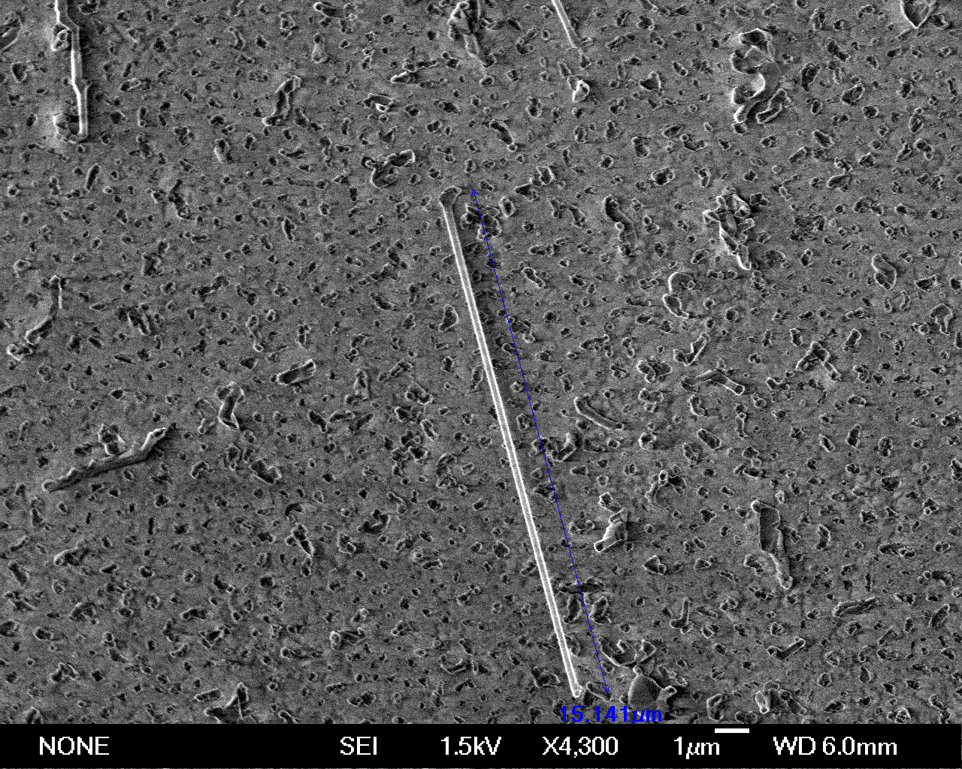
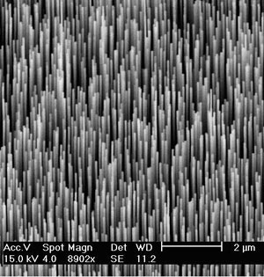
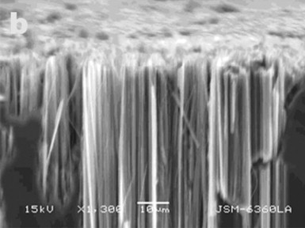
What is a Nanowire?
“One-dimensional” structure
Diameter: 1-100 nanometers (10⁻⁹ m)
Length: microns (10⁻⁶ m)
Exhibits crystal structure
Unlike quantum “dots” (0-dimensional)
Many different materials
Metals, semiconductors, oxides
Notes:
Thin human hair: 100 microns
Mouse embryonic stem cell, silicon array
GaN single wire
ZnO array
Si array
(all SEM)
First, the diameter puts the radial dimension of these structures at or below the characteristic length scale of various interesting and fundamental solid state phenomena: the exciton Bohr radius, wavelength of light, phonon mean free path, critical size of magnetic domains, exciton diffusion length, and others

Slide 3
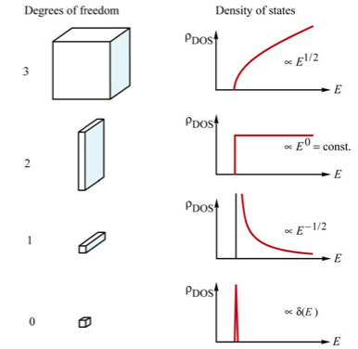
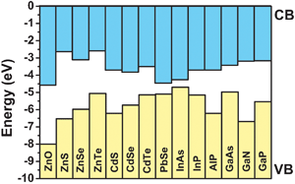
Features of Nanowires
Smallest dimension which can transport charge carriers (e⁻, h⁺)
Can act as both nanoscale devices and wiring
Unique density of states
Controlled synthesis
Diameter, length, composition
Electronic structure (band gap, doping)
Size
Quantum confinement
Present in some, absent in others
Unique magnetic & electronic properties
Millions more transistors per microprocessor
Probe microscopic systems (e.g. cells)

Slide 4
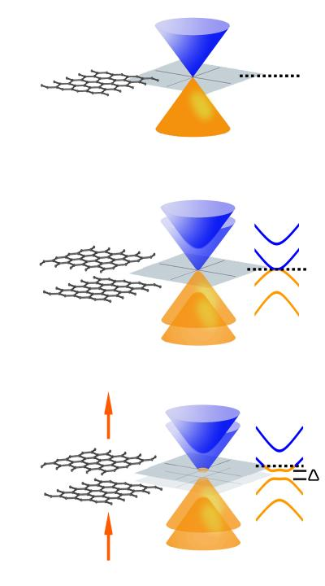
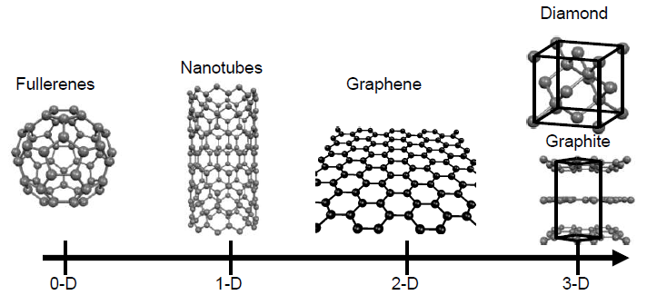
Graphene Reminder
Graphene is a 2-d from of pure carbon
Band gap depends on structure
Large area monolayers
Bilayers
Nanoribbons

Slide 5
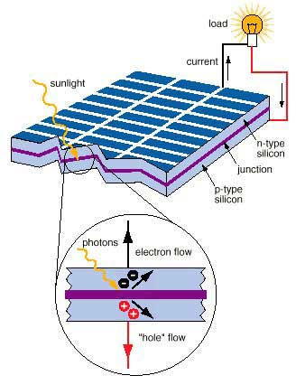
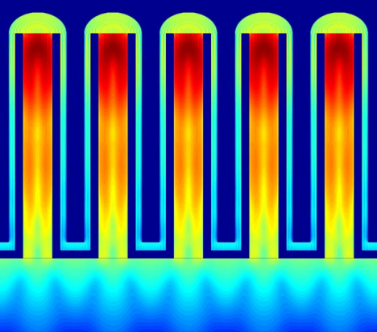
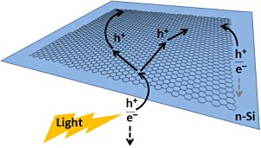
Solar Cells
Currently: silicon wafers, thin films
Application of graphene:
Transparent conducting electrodes
Robust, conductive, abundant
Cheaper than ITO
Application of nanowires:
Enhanced light trapping
Efficient charge transport (1D)
Notes:
Graphene:
http://pubs.acs.org/doi/pdf/10.1021/nl303920b
Shottky junction (metal-semiconductor): light passes through the transparent graphene film to the silicon layer, where it induces the formation of electron–hole pairs. These charge pairs then separate, with the electrons moving toward the silicon, and the holes toward the graphene.

Slide 6
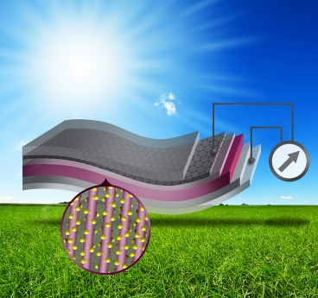
Graphene-Nanowire Solar Cells
A new design:
Layer of graphene (transparent cathode)
Conductive polymer (maintains integrity)
ZnO nanowire layer (electron transport)
PbS quantum dots (hole transport)
Au layer (anode)
Efficiency approaches ITO-based solar cells
4.2% conversion efficiency (5.1% for ITO)
Cheaper to produce
Notes:
Charge separation: electrons travel up to graphene, holes travel down

Slide 7
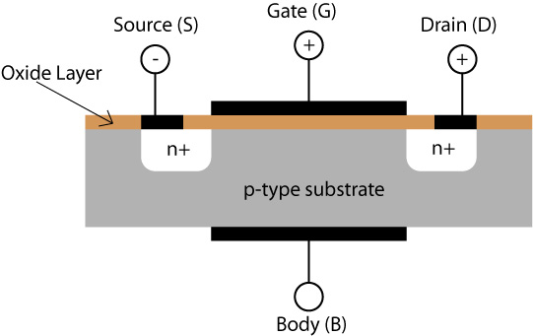
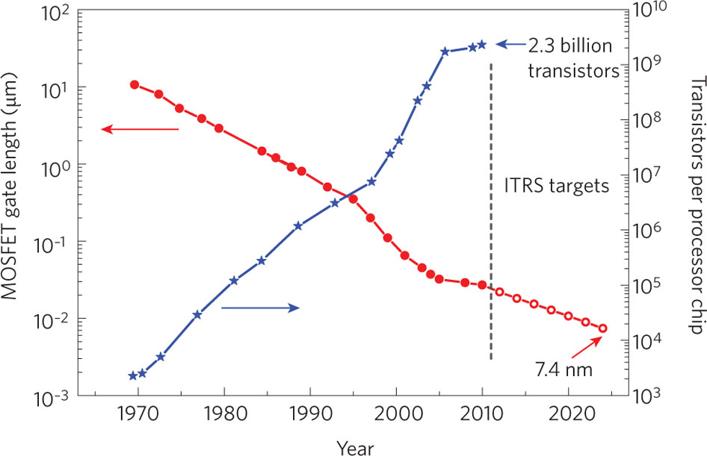
Field Effect Transistors
Challenges to scaling
Lower transconductance
Manufacturing difficulties
Quantum effects
Gate capacitance
Notes:
http://www.nature.com/nnano/journal/v5/n7/fig_tab/nnano.2010.89_F1.html

Slide 8
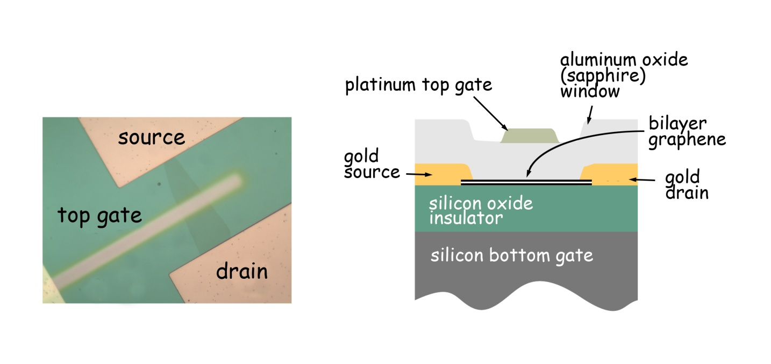
Graphene FETs
Advantages
High room temperature mobility
Thinner than traditional MOSFETs
Challenges
Low on-off ratios
High graphene-electrode contact resistance
Tradeoff between mobility and bandgap
Notes:
http://newscenter.lbl.gov/news-releases/2009/06/10/graphene-bandgap/

Slide 9
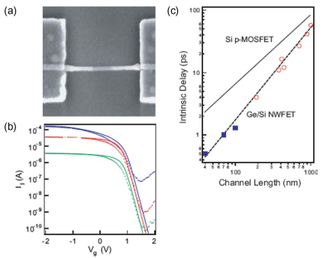
Nanowire FETs
Advantages
Many different nanowires with different properties
High mobility
“Bottom up” synthesis
Challenges
Integrating NW into circuit
Control of growth and dopants
Notes:
http://cmliris.harvard.edu/assets/IEEETransED_55-2859_Lu.pdf

Slide 10
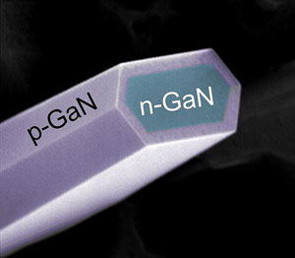
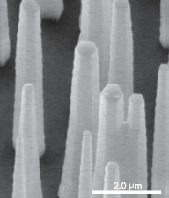
Light-Emitting Diodes
LEDs versus conventional lighting:
Efficient: less heat, lower power consumption
Long lifetime
Cheap
No mercury
How nanowires help:
Various geometries of p-n junctions available
Coaxial wires
Thin film/wire combinations
Crossed-wire junction arrays
Unique carrier transport properties
Natural waveguiding cavities
Improve extraction efficiency of light
High surface area improves conductivity
Notes:
Marvell Nanofabrication Laboratory (5th floor, Sutardja Dai Hall)
p-GaN (3.43 eV) thin film, vertical n-ZnO (3.37eV) array
Direct band gap needed for radiative recombination
Lots of reflection due to much higher refractive index in semiconductor medium
http://www.cchem.berkeley.edu/pdygrp/pub_files/pubpdf/170.pdf
http://pubs.acs.org/doi/pdf/10.1021/jp051813i

Slide 11
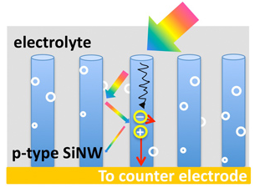
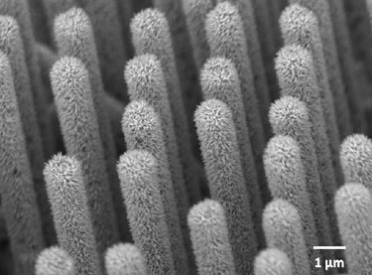
Artificial Photosynthesis
Simulate natural photosynthetic process
Convert CO₂ and H₂O into fuels, O₂
H₂O oxidation
CO₂ reduction
How nanowires help: photoelectrodes
High surface area for reaction sites
High charge mobility due to small diameter
Can be grown in large quantities
Notes:
http://nanowires.berkeley.edu/wp-content/uploads/2013/01/211.pdf
http://pubs.acs.org/doi/pdf/10.1021/nl100665r
http://www.cchem.berkeley.edu/pdygrp/pub_files/pubpdf/216.pdf
coating n-doped Si wire arrays with n-type InGaN nanowires and annealing the ensemble at high temperatures
Can add lots of catalysts to the InGaN
Photocurrent density 5x higher than if on planar Si

Slide 12
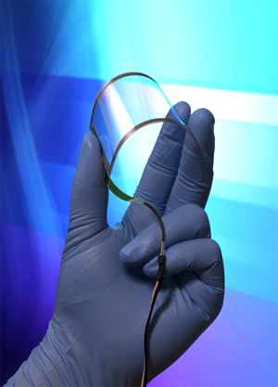
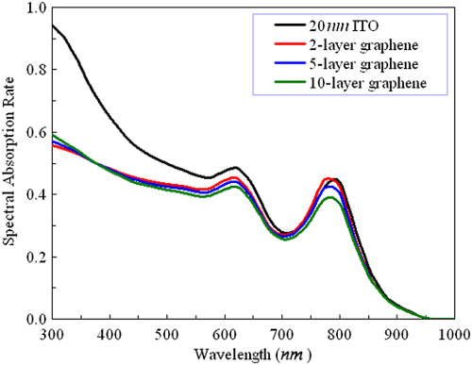
Touch Screen Devices
Graphene is strong, transparent, highly conductive, and cheaper than traditional ITO
Notes:
Graphene absorbs less than ITO, which is what is commonly used now.
http://www.nature.com/am/journal/v2/n4/full/am2010103a.html

Slide 13
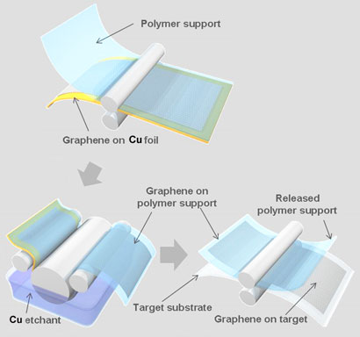
Notes:
This is how graphene is transferred to a polymer for support for potential use in touchscreens.

Slide 14
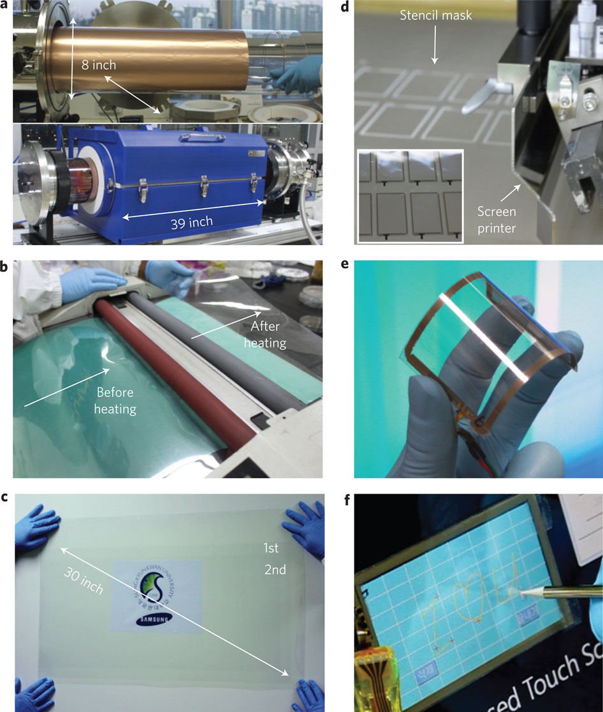
This is scalable!

Slide 15
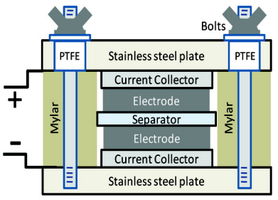
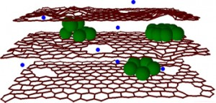
Ultracapacitors
Graphene advantages:
High surface area to weight ratio (2600 m² /g)
High conductivity
Measured specific capacitance 135 F/g
Uses:
Electric vehicles
Backup powering
High power capability
Cell phones
Notes:
http://bucky-central.me.utexas.edu/RuoffsPDFs/179.pdf
http://www.extremetech.com/computing/105343-graphene-improves-lithium-ion-battery-capacity-and-recharge-rate-by-10x
http://bucky-central.me.utexas.edu/RuoffsPDFs/179.pdf

Slide 16
References
Physical Foundations of Solid State Devices, E. F. Schubert
Y. J. Hwang, et al., Nano Lett., 2012, 12, 1678–1682
A. Hochbaum, Chem. Rev., 2010, 110, 527–546
H. Park, et al., Nano Lett., 2013, 13, 233-239
E. Lai, et al., Nano Res., 2008, 1, 123-128
D. Siburly, et al., J. Phys. Chem, 2005, 109, 15190-15213
F. Schwarz, Nature Nanotechnology, 2010, 5, 487–496
S. Bae, et al., Nature Nanotechnology, 2010, 5, 574–578
M. Stoller, et al., Nano Lett., 2008, 8, 3498–3502
Y. Zhang, et al., Nature, 2009, 459, 820-823

